Slide 1
LangChain4j with Spring Boot
Author: Konrad Kowalczyk
Repository: xkondix AI Sandbox

Slide 2

Presentation Plan
Introduction
Configuration
Integration with LLMs
Chat
Chat with memory
Retrieval-Augmented Generation (RAG)
Tools (Function Calling)
Model Context Protocol (MCP)
Questions

Slide 3
Introduction
A Large Language Model (LLM) is an advanced AI model trained on massive amounts of text data to understand and generate human-like language.
It can answer questions, write code, summarize documents, translate languages, and much more.
Token is a basic unit of text (like a word or part of a word) that language models use to process and generate responses.
The purpose of this presentation and project is to demonstrate how you can easily integrate Spring Boot with LLM using the LangChain4j library.

Slide 4
Configuration
Project Setup
LangChain4j dependencies
Docker compose

Slide 5
Project Setup
Spring Boot 3.5.3 (with LangChain4j)
JAVA 21
Ollama for local LLMs
Redis for memory
ChromaDB for vector store

Slide 6
LangChain4j dependencies
Useful dependencies (more in project):
langchain4j & langchain4j-core (core)
langchain4j-open-ai (gpt api)
langchain4j-ollama (local LLMs)
langchain4j-embeddings (models converting text -> vectors)
langchain4j-embeddings-all-minilm-l6-v2-q (model used in project)
langchain4j-chroma (chromaDB used as a vector database in the project)
langchain4j-redis (used as a permanent chat memory in the project)

Slide 7
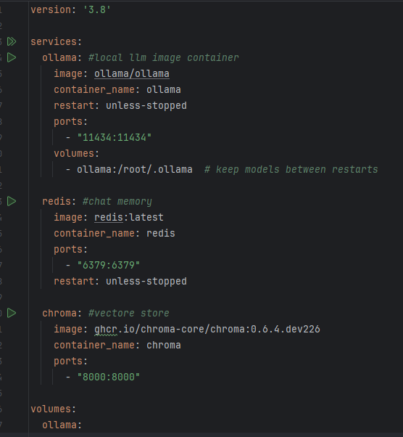
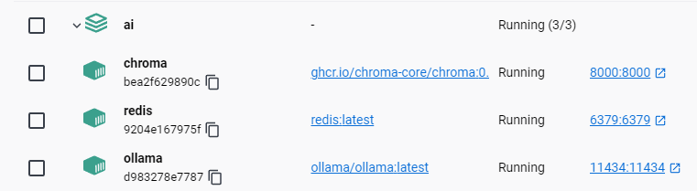
Docker compose
Steps required to download LLMs:
docker compose up -d
docker exec -it ollama bash
ollama pull gemma3:4b
ollama pull llama3.1:8b

Slide 8
Integration with LLMs
Modal Parameters
Local (gemma3 & llama3.1)
API (OpenAI chat GPT)

Slide 9
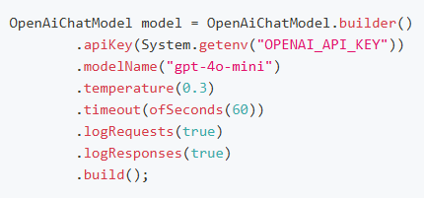
Model Parameters
modelName the name of the model (e.g. gemma3:4b).
temperature (0–2)
Higher = more random
Lower = more deterministic
maxTokens the maximum number of tokens that can be generated in the chat completion.
more here doc

Slide 10
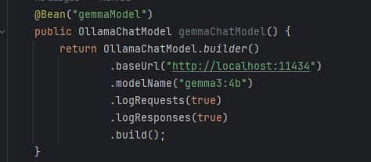
Local (gemma3)

Slide 11
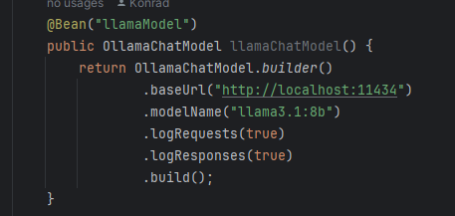
Local (Ilama 3.1)

Slide 12
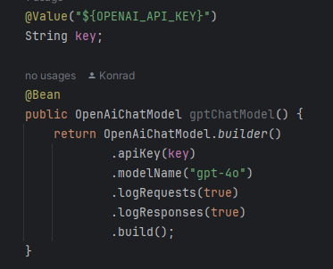
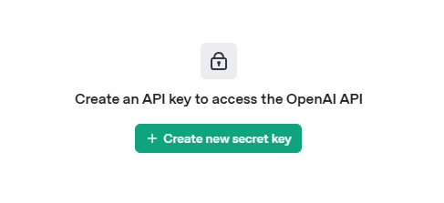
API OpenAI chat GPT
Using ChatGPT in your application requires an OpenAI API key and specifying the desired model (like gpt-4) when making requests to the API.
Link to create a key GPT key

Slide 13
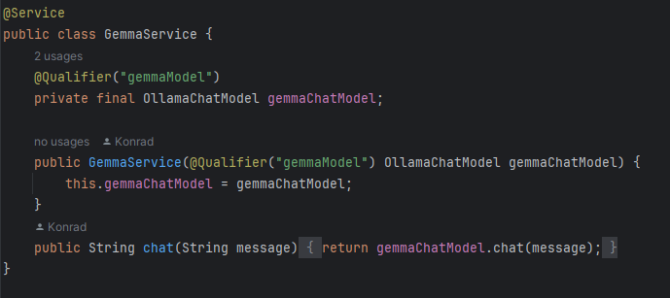
Chat

Slide 14
Chat with memory
Before (AiServices)
Temporary Memory
Permanent Memory (redis)

Slide 15

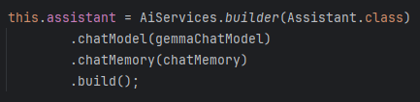
AiServices
AI Services in LangChain4j provide a declarative interface to interact with LLMs.
Models, hiding the complexity behind simple, annotated methods.
It supports features such as:
Memory
Tools
RAG

Slide 16
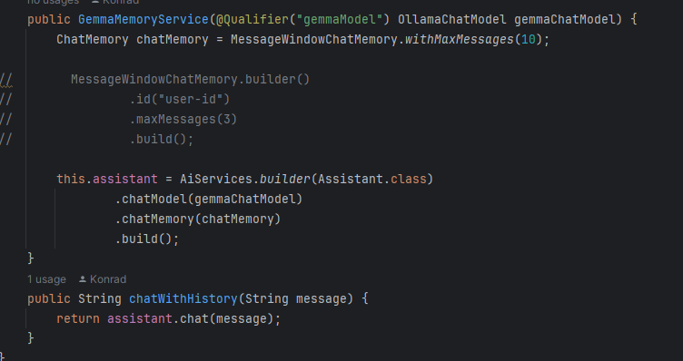
Temporary memory
There are two common approaches for temporary memory:
with user
without user

Slide 17
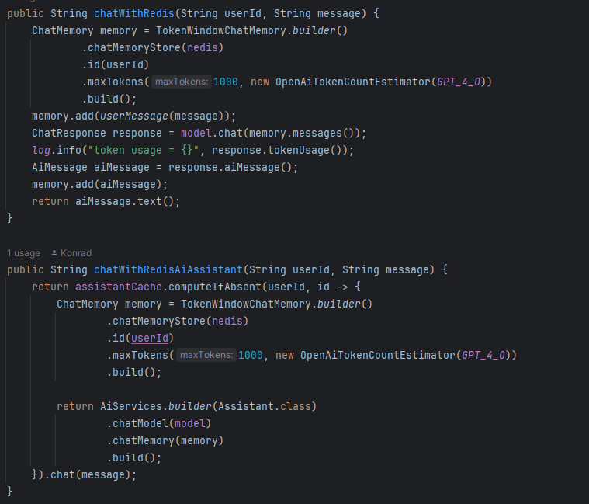
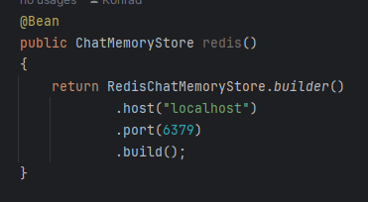
Permanent Memory (redis)
Redis is an in-memory data store that we can use to persist chat memory across sessions.
Before using it, we need to configure the Redis database and integrate it with our application (as shown in the setup screenshots).

Slide 18
Retrieval-Augmented Generation (RAG)
Retrieval-Augmented Generation (RAG) is a technique that improves language models by retrieving relevant external information to generate more accurate and context-aware responses.
Documents Search
Web Search
Database Search

Slide 19
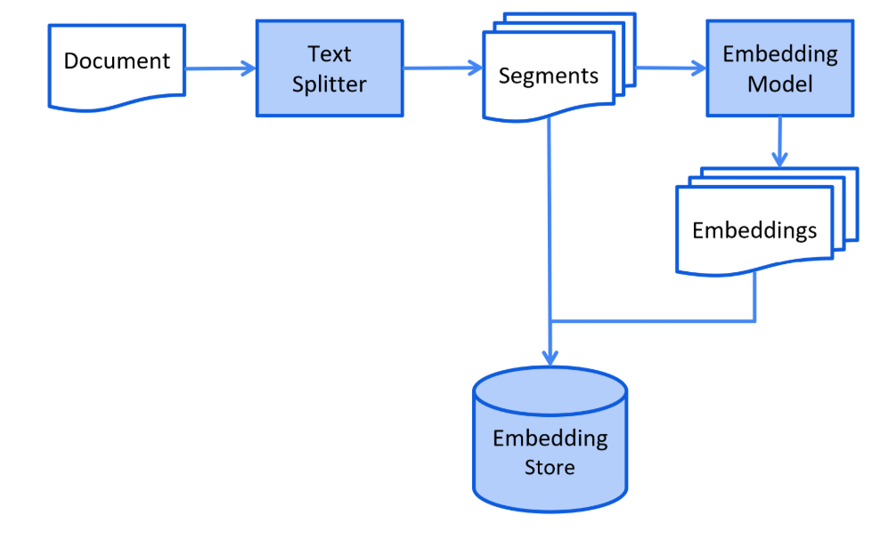
Retrieval-Augmented Generation (RAG)
source: https://docs.langchain4j.dev/tutorials/rag

Slide 20
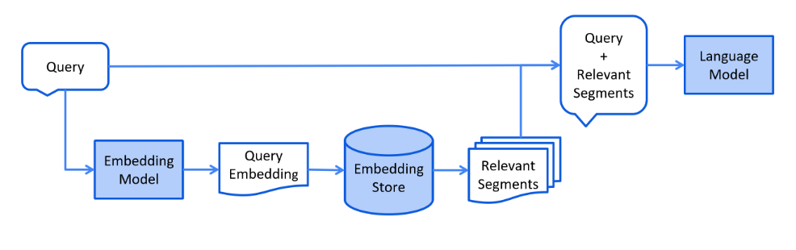
Retrieval-Augmented Generation (RAG)
source: https://docs.langchain4j.dev/tutorials/rag

Slide 21
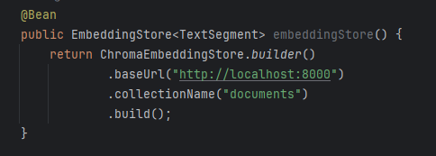
Documents Search
The provided configuration in the project is adapted specifically for document-based RAG. It uses Chroma vector storage and embedding model to process and retrieve relevant text segments from uploaded files.
Source:
Local documents
PDF files
Texts

Slide 22
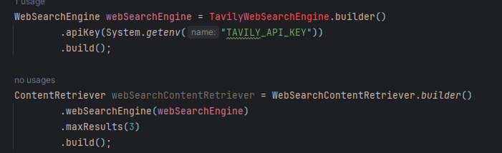
Web Search
Before you start, you need to create an account at Tavily platform to obtain an API key.
You can also choose a different web search engine, but this one is recommended.
Example: Web Search Example

Slide 23
Database Search
Before you start, you need create connection to database.
Example: Database Search Example

Slide 24
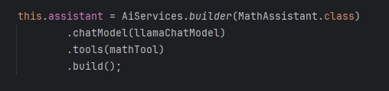
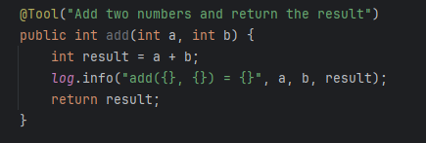
Tools (function calling)
Tools let an LLM indicate when it needs to use an external function or API by requesting a specific tool call with arguments instead of answering directly.
This means that we can provide a function written in JAVA with an appropriate description that will be called to get the answer, such as the add method as in the example.

Slide 25
Model Context Protocol (MCP)
Model Context Protocol (MCP) is a standard that allows LLM to communicate with external MCP-compliant servers that provide and execute tools via HTTP or stdio protocols.
LangChain4j supports MCP, allowing clients to connect to these servers, download available tools and use them during AI interactions, enabling seamless integration of external functions into AI workflows.
Example: MCP Example

Slide 26

Questions? Thanks for your time!

